Slide 1
Address Sanitizer + Fuzzing + VS2019
jradigan@Microsoft.com

Slide 2
Memory safety - continues to dominate
Discovered vulnerabilities continue to increase
~70% of all reported - due to memory safety

Slide 3
Sanitizers + fuzzing
…de facto standard for detecting memory safety issues.

Slide 4
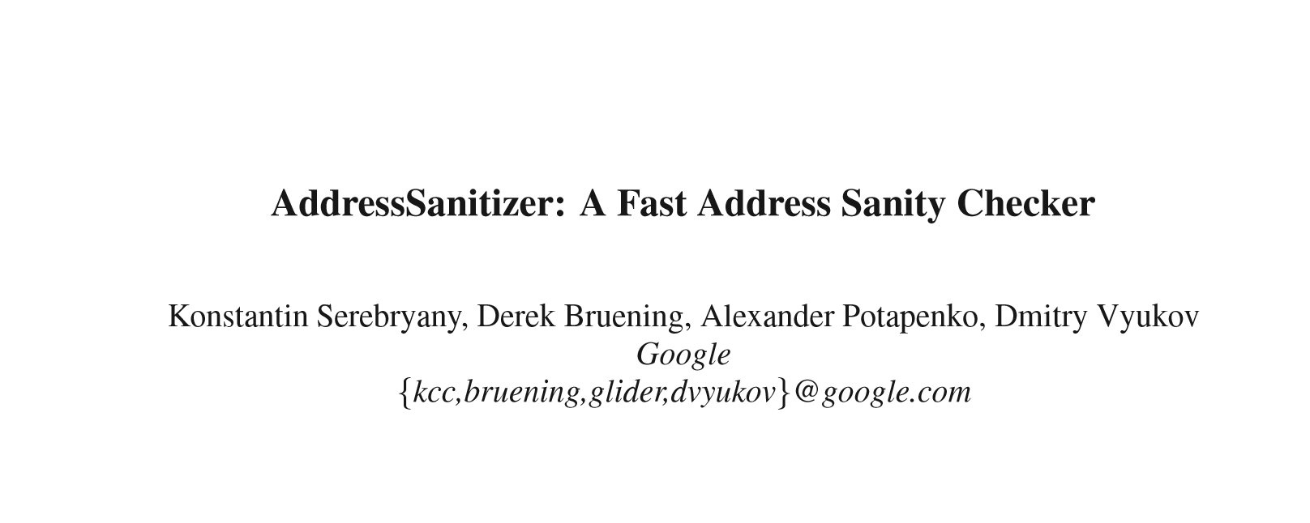


Slide 5
Thank you Konstantin Serebryany

Slide 6
CORECTNESS
ASAN
DEVELOPMENT

Slide 7
Correctness
Why is it confusing ?

Slide 8
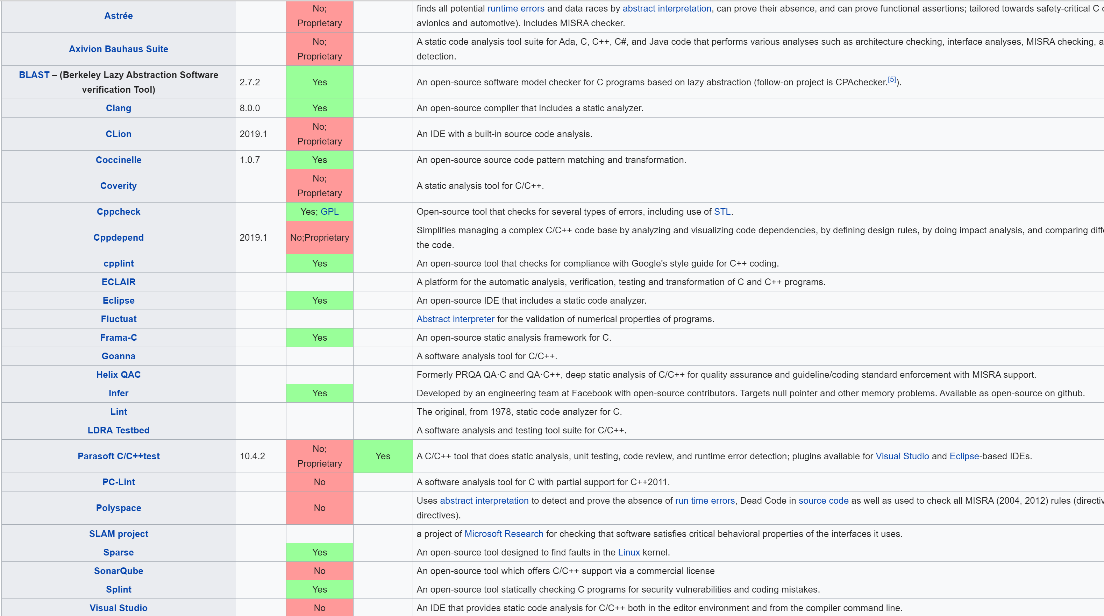

Slide 9
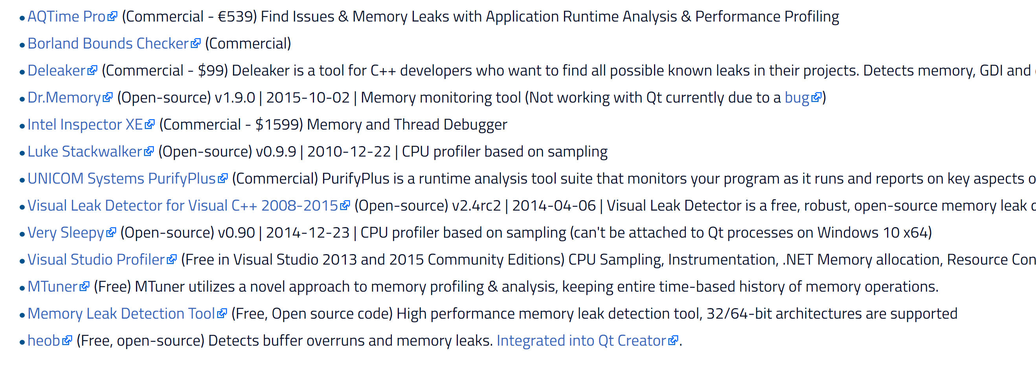

Windows
Linux

Slide 10
Correctness - core issues thwarting analysis
POINTERS
TYPES
+ EXTERNAL BINARY LIBS - exacerbate the above

Slide 11
Pointers Types
*p = a + b; // Does p alias {a,b}
= a + b;
o = new Foo;
*q =
o->MyVirtual() // did q change type(o)
Global_ptr =
Obj->MyVirt(&p) // Devirtualize?
= *Global_ptr // point to?

Slide 12
Basics – Object and VTable
??_7Foo@6:
Type *Obj
func1()
Field 1
func2()
Field 2
func3()
Field 3
func4()
func5()
func6()
func7()

Slide 13
Core issue in C++ program analysis
Type propagation
Alias analysis

Slide 14
Address Sanitizer – eliminates the cycle
Overloaded term. What is it ?

Slide 15
Address Sanitizer
Compiler
Instrumentation code, stack layout, and calls into RT
Meta-data in OBJ for the runtime
Sanitizer Runtime
Malware or “hooking” – malloc, free, memset, etc.
Error analysis and reporting
Does not require complete recompile
Zero false positives

Slide 16
“Secure by Coincidence”
void *func(char *buf, size_t sz) {
void *local = malloc(sz);
for (auto ii = 0; ii <= sz; ii++) {
local[ii] = ~buf[ii];
}
return local;
}
When sz % 16 == 0 the final write to local will corrupt data
Other cases will only read/write to “malloc slop”
Will only be observable:
If following page is unmapped/non-writable
On use of corrupted data
All other cases are silent
.

Slide 17
A Shadow Byte
(User_Address >> 3) + 0x30000000
*( ) = 0xF8;

Slide 18
One Shadow Byte – describing 8-bytes
1,2,3,4,5,6,7 - of the 8 bytes are accessible
0 - all of the 8 bytes are accessible
0xF8 - use after scope
0xF3 - right red zone
0xF2 - mid red zone
0xF1 - left red zone
…

Slide 19
Simplified Code Generation
*p = x + y;
if (ShadowByte::Bad(p) )
AsanRt::Report(p,sz)
*p = x + y
MANY complex functionalities are then layered upon this.

Slide 20
Two variables on the stack
0xF1 | 0xF1 |  |  | 0xF2 | 0xF2 | 0xF2 | 0xF2 |  | 0xF3
0xF8
Left Red Zone
Mid Red Zone
Right Red Zone

Slide 21
ASan Runtime
call Malloc
_malloc:
Malloc Body
call Malloc
_malloc:
jmp _asan_malloc
Malloc Body
_asan_malloc:
ASAN WORK
jmp malloc + 5

Slide 22
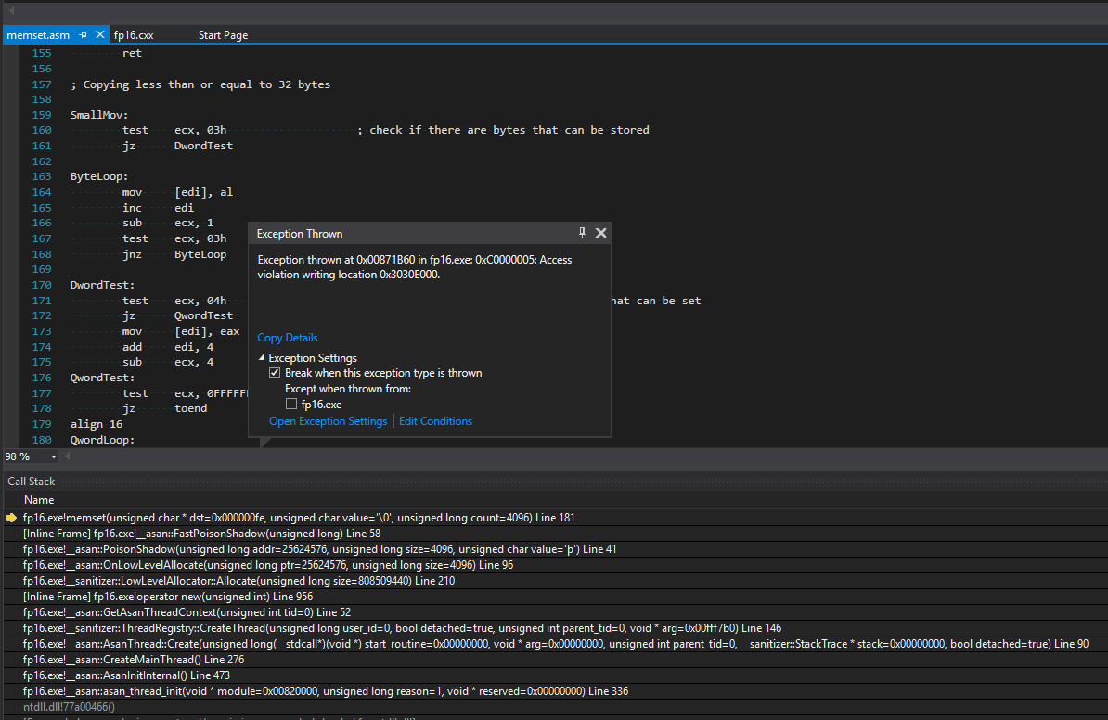

Slide 23
Address Sanitizer
Why’d we do it ?

Slide 24
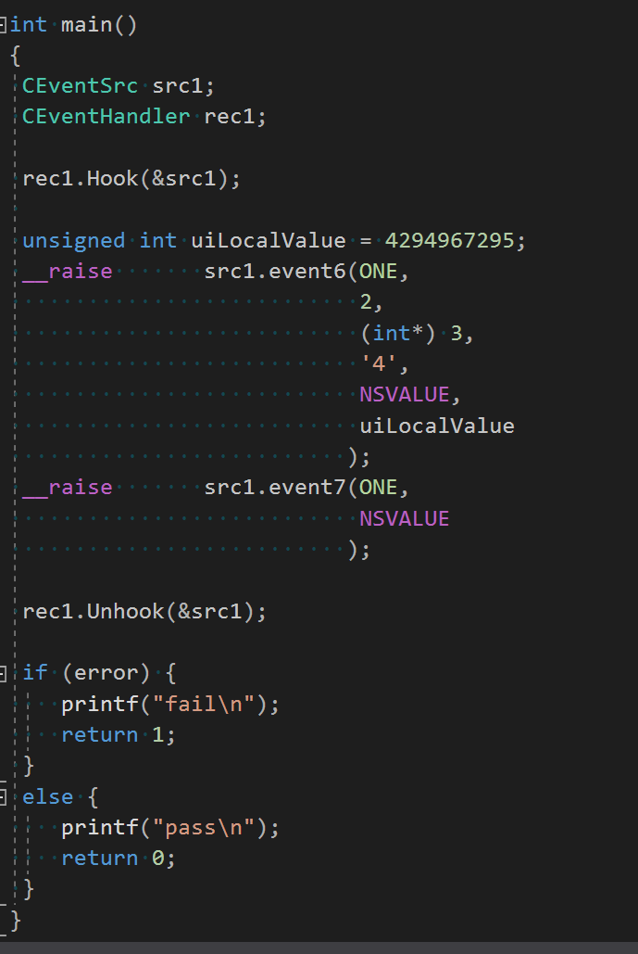
C++ COM + Address Sanitizer Compiler auto generates _event dispatching methods Specify a number of “hooks” called when “_raise”

Slide 25
Test Passed - for 7 years
Running the test (dev11\tfs184850.exe)
=================================================================
==19988==ERROR: AddressSanitizer: new-delete-type-mismatch on 0x046006f0 in thread T0:
object passed to delete has wrong type:
size of the allocated type: 16 bytes;
size of the deallocated type: 8 bytes.
#0 0xb3a88f in operator delete(void *,unsigned int) d:\_work\5\s\llvm\projects\compiler-rt\lib\asan\asan_new_delete.cc:179
#1 0xafe34a in CEventSrc::__RemoveEventHandler_CEventSrc_event6<class CEventHandler>(class CEventHandler *,void ( CEventHandler::*)(enum ENUM_TYPE,int,int *,char,double,unsigned int &)) *C:\msvc\msvc\src\qa\BE\Regress\dev11\tfs184850.inj:2:68
#2 0xaff099 in main C:\msvc\msvc\src\qa\BE\Regress\dev11\tfs184850.cpp:99
#3 0xb3b802 in _scrt_common_main_seh d:\agent\_work\1\s\src\vctools\crt\vcstartup\src\startup\exe_common.inl:288
#4 0xaf9ae2 in nogpfntStartup (C:\msvc\msvc\src\qa\BE\Regress\dev11\tfs184850.exe+0x409ae2)
#5 0x756a0178 (C:\WINDOWS\System32\KERNEL32.DLL+0x6b820178)
#6 0x779b662c (C:\WINDOWS\SYSTEM32\ntdll.dll+0x4b2e662c)
#7 0x779b65fc (C:\WINDOWS\SYSTEM32\ntdll.dll+0x4b2e65fc)
0x046006f0 is located 0 bytes inside of 16-byte region [0x046006f0,0x04600700)
allocated by thread T0 here:
#0 0xb3a238 in operator new(unsigned int) d:\_work\5\s\llvm\projects\compiler-rt\lib\asan\asan_new_delete.cc:106
#1 0xafde0e in CEventSrc::__AddEventHandler_CEventSrc_event6<class CEventHandler>(class CEventHandler *,void ( CEventHandler::*)(enum ENUM_TYPE,int,int *,char,double,unsigned int &)) *C:\msvc\msvc\src\qa\BE\Regress\dev11\tfs184850.inj:2:35
#2 0xaff004 in main C:\msvc\msvc\src\qa\BE\Regress\dev11\tfs184850.cpp:85
#3 0xb3b802 in _scrt_common_main_seh d:\agent\_work\1\s\src\vctools\crt\vcstartup\src\startup\exe_common.inl:288
#4 0xaf9ae2 in nogpfntStartup (C:\msvc\msvc\src\qa\BE\Regress\dev11\tfs184850.exe+0x409ae2)
#5 0x756a0178 (C:\WINDOWS\System32\KERNEL32.DLL+0x6b820178)
#6 0x779b662c (C:\WINDOWS\SYSTEM32\ntdll.dll+0x4b2e662c)
#7 0x779b65fc (C:\WINDOWS\SYSTEM32\ntdll.dll+0x4b2e65fc)

Slide 26
Fuzzing
What is it?

Slide 27
Automatically generate inputs to you program to blow it up.

Slide 28
Asan + fuzzing
**p = 13
if ( x[i] < 37)
**p = 13
if (x[i] < 37) {
q->field = 13
}
else {
obj->foo(&q)
if(q != nullptr)
memcpy(q, input)
}
printf(…);
q->field = 13
obj->foo()
if (q != nullptr)
CHK(memcpy, q, input)
printf(... )
(1-D linear) (2-D graph – or exact paths)

Slide 29
Fuzzing
Ensures red paths with Asan checks
… ALL execute.
CHK (memcpy,q,input)

Slide 30
Blackbox fuzzing
“stuck evenflew”
…
…
“stukk ovenflew”
…
…
“stuck overflew”
…
…
“stack overflow”
SEED
Permutation
Permutation
EXCEPTION

Slide 31
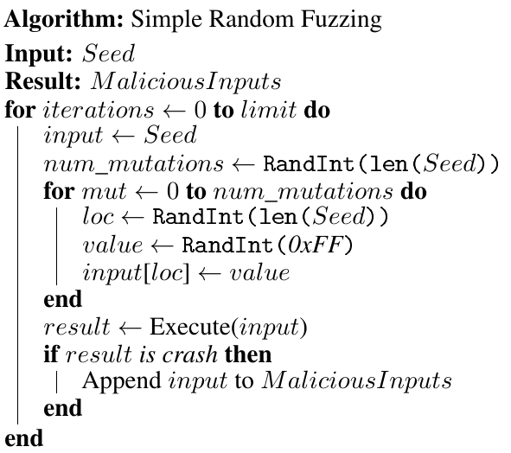
Blackbox fuzzing
Notes:
Improve robustness by exposing software to crafted malicious or corrupt input
A program under test is executed with many (millions+) malformed or maliciously crafted inputs.
Maliciously crafted inputs are automatically generated
Fast and cheap. Thousands of inputs tested per second
Effective at finding program misbehavior

Slide 32
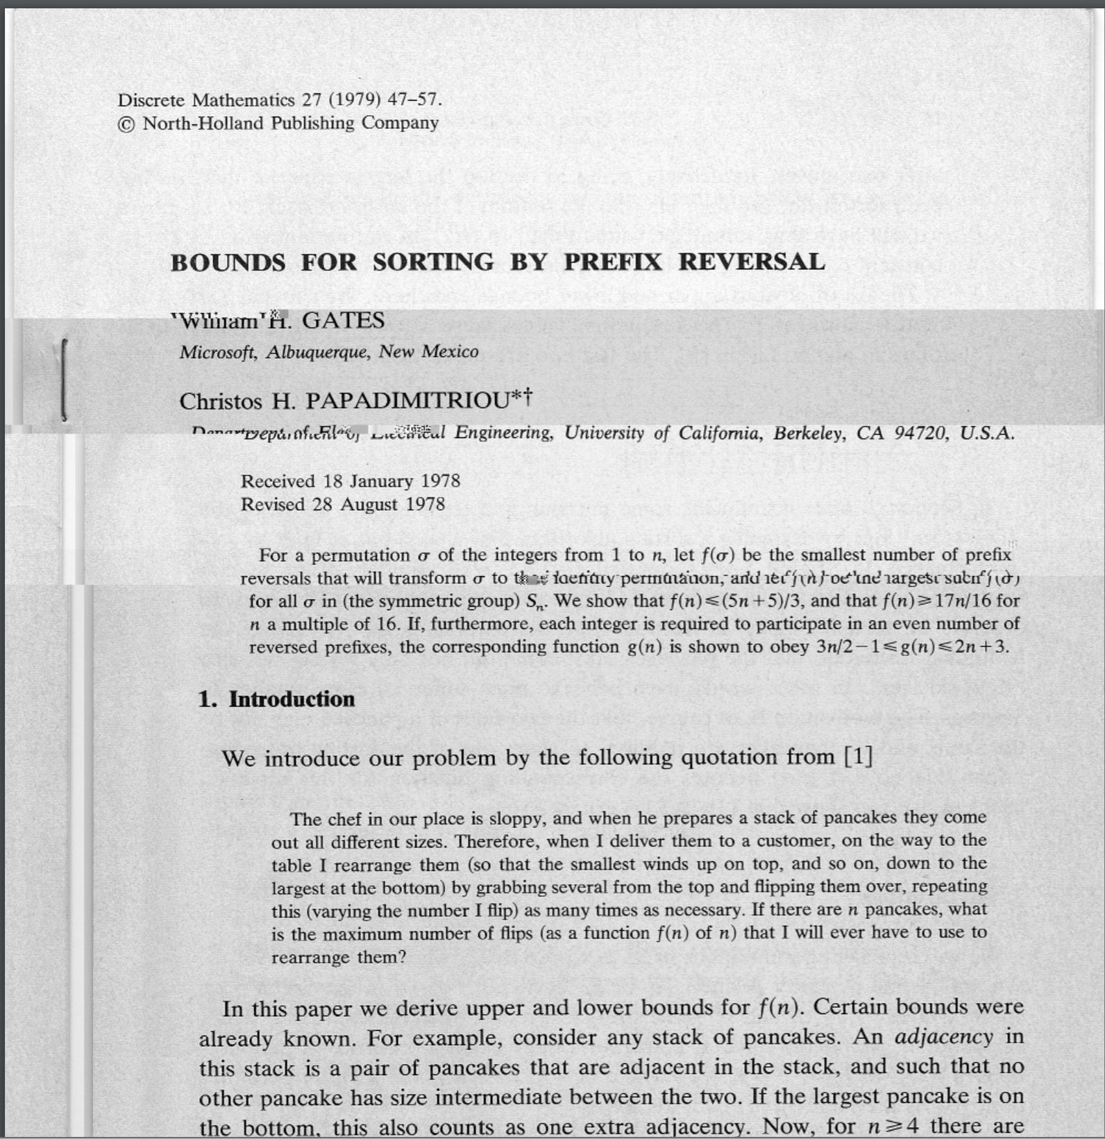
Input Seed Scanned PDF

Slide 33
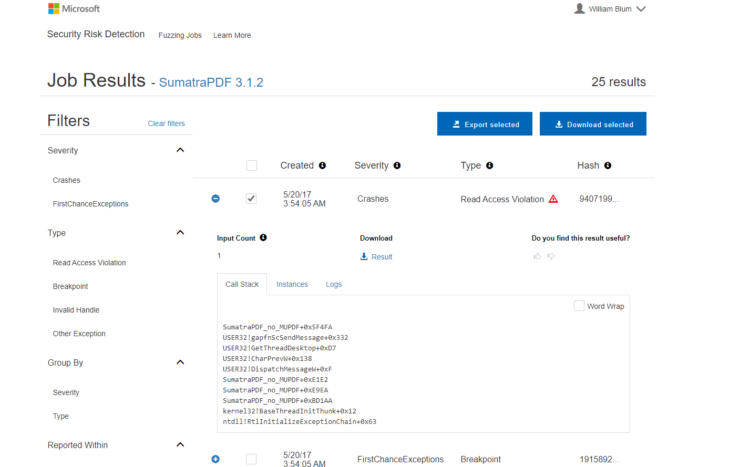
MSRD Results

Slide 34
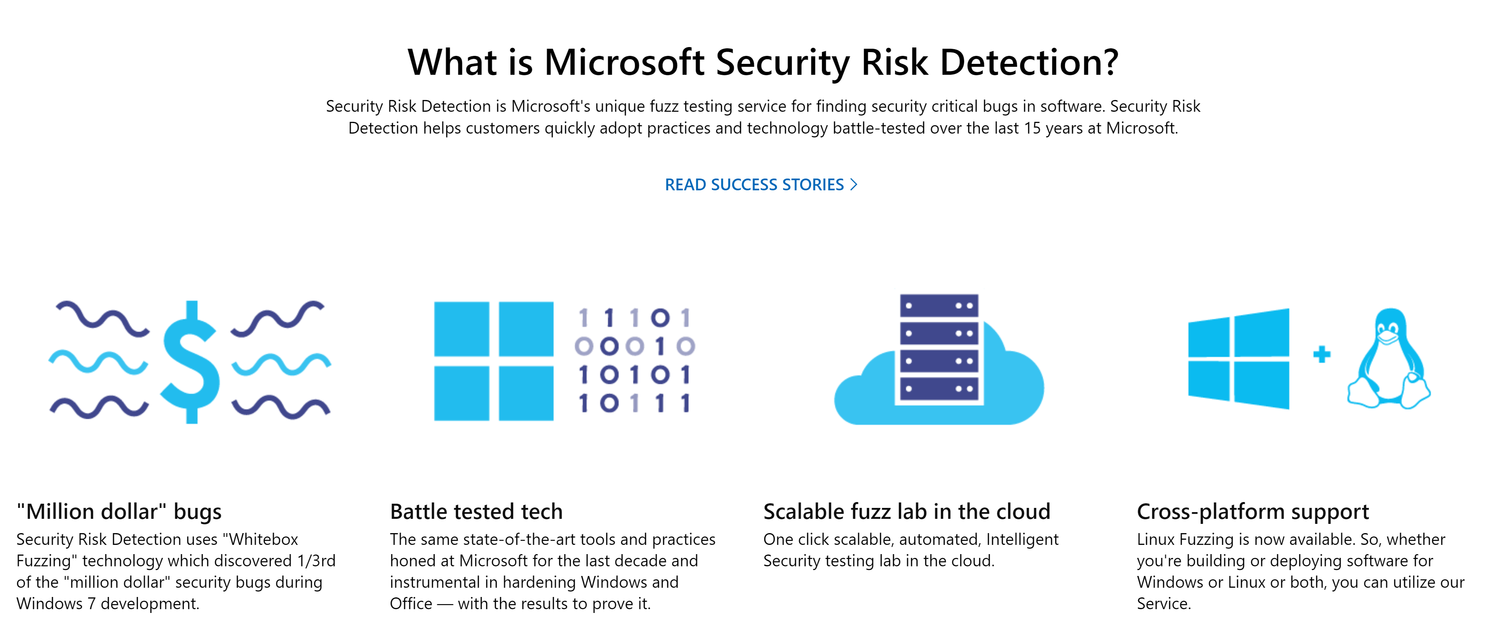
Microsoft Security Risk Detection MSRD
Scales in the Cloud
Bundled Fuzzers
Web Scanning
Rest API’s
AI and Whitebox

Slide 35
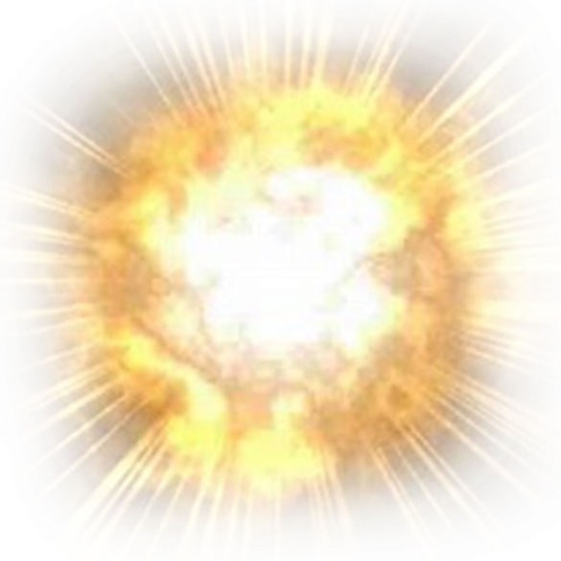
Microsoft Security Risk Detection ‘Whitebox’ fuzzing
Round 1
Round 2
Round 3
Round 4
void top(char input[4])
{
int cnt = 0;
if (input[0] == ‘b’) cnt++;
if (input[1] == ‘a’) cnt++;
if (input[2] == ‘d’) cnt++;
if (input[3] == ‘!’) cnt++;
if (cnt >= 4) crash();
}
Input
=
“good”
Input
=
“bood”
Input
=
“baod”
Input
=
“badd”
Input
=
“bad!”
Path constraint:
I₀!=‘b’
→ I₀=‘b’
bood
…
…
I₁!=‘a’
→ I₁=‘a’
gaod
baod
badd
…
I₂!=‘d’
→ I₂=‘d’
godd
…
…
bad!
I₃!=‘!’
→ I₃=‘!’
goo!
good
MSRD threw 3.8 Billion queries like this at Windows 8 and had an average answer time of 1/10th of a second
Notes:
So fuzzing starts with seed input "good". Runs the program on it and observes that none of the if branches were taken. So after that first execution (=iteration), Sage tries to satisfy one the condition being tested in the 4 "if" statements, this gives 4 possible mutations, the first one gives a new input "bood".
Next iteration, starting from "bood", sage tries to satisfy the next constraint, this produces "baod".
Etc...
At the fourth iteration, sage has inferred "bad!".
Below is a demo program, it will only crash with “BAD!” as an input, but how would you figure that out? Black box fuzzing would not find this bug, and if you just had the binary, not the source code, you could not find it on you own. Microsoft can answer this question in 2 and a half minutes with MSRD using Whitebox Fuzzing.
What if we could teach a computer to find bugs like a human?
Here’s an example piece of code. You and I can see that the input “bad!” will cause a crash.
Now imagine you just have the machine code, the low level 1s and 0s fed to your processor.
A human can still figure it out, but it takes time and training.
I ask people at security conferences how long it would take them, they tell me 10 minutes.
Mark Russinovich tells me he can do it in 5 minutes. I believe him.
There’s only one Mark Russinovich, and there’s not that many trained security people.
I was at security summer camp last June, and if a meteor had hit, we would have set the field back years.
Microsoft can solve this problem using a computer in 2 and a half minutes. Let me show you how.
Billions and Billions of Constraints: Whitebox Fuzz Testing in Production
http://www.microsoft.com/en-us/research/publication/billions-and-billions-of-constraints-whitebox-fuzz-testing-in-production/
Z3 won Association for Computing Programming Languages Software Award
https://www.microsoft.com/en-us/research/blog/z3-wins-2015-acm-sigplan-award
Z3 Wiki
https://github.com/Z3Prover/z3/wiki

Slide 36
Data trust boundary – “interesting” to Fuzz
while ( … ) {
n = read (socket, buffer +ptr, sizeof(buffer) – ptr);
ptr += n;
}

Slide 37
Compile for Asan + Fuzz … ~self diagnosing
Compile +Asan RT
Fuzzing

Slide 38
Development Process
Incorporate Asan + Fuzzing !

Slide 39
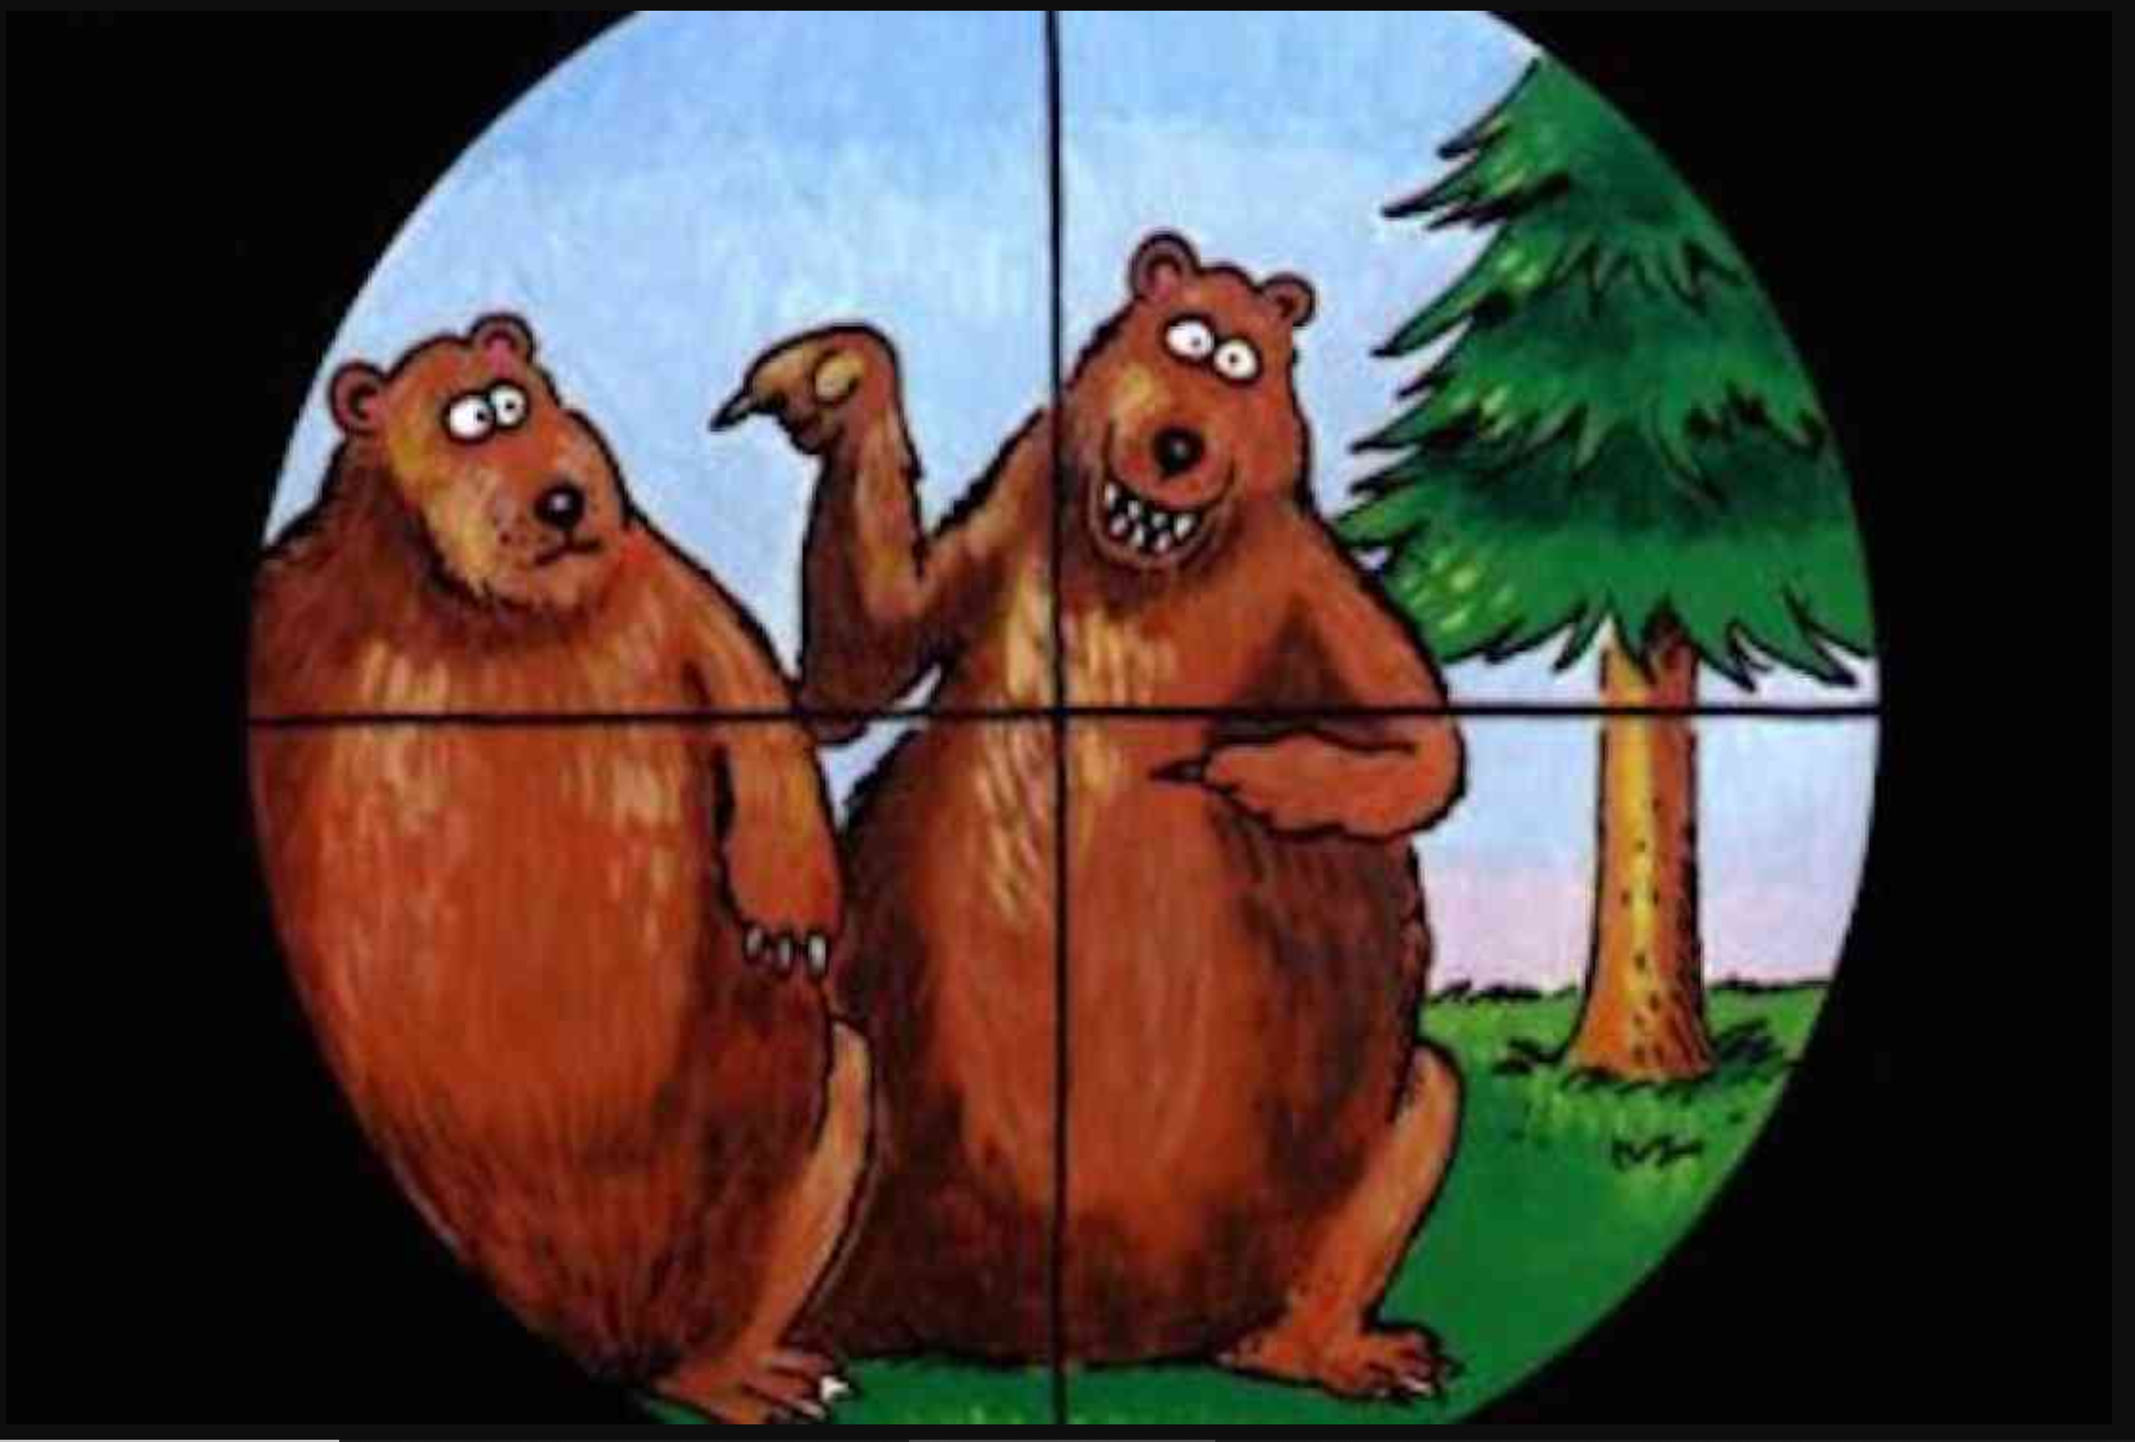
Workflow

Slide 40
Workflow
Compile –fsanitize=address
“Fling” build and inputs at 40 cloud machines
Process failures

Slide 41
What does that look like?

Slide 42

Azure/IDE – Workflow
Azure
Machine
MSRD
Azure
Machine
Azure
Machine
Azure
Machine
Laptop
VS2019
ASAN Compiler +RT
IDE
Azure
Machine
Teams IM
Azure
Machine
Azure
Machine
BUCKET unique errors
Azure
Machine
Azure
Machine
Remote Debug
Unique failure
Azure
Machine
Snapshot
Files for VS
Azure
Machine

Slide 43
CLANG/LLVM
=================================================================
==27748==ERROR: AddressSanitizer: stack-use-after-scope on address 0x0055fc68 at pc 0x793d62de bp 0x0055fbf4 sp 0x0055fbe8
WRITE of size 80 at 0x0055fc68 thread T0
#0 0x793d62f6 in __asan_wrap_memset d:\_work\5\s\llvm\projects\compiler-rt\lib\sanitizer_common\sanitizer_common_interceptors.inc:764
#1 0x77dd46e7 (C:\WINDOWS\SYSTEM32\ntdll.dll+0x4b2c46e7)
#2 0x77dd4ce1 (C:\WINDOWS\SYSTEM32\ntdll.dll+0x4b2c4ce1)
#3 0x75d408fe (C:\WINDOWS\System32\KERNELBASE.dll+0x100f08fe)
#4 0xa5ada0 in try_get_first_available_module minkernel\crts\ucrt\src\appcrt\internal\winapi_thunks.cpp:271
#5 0xa5ae99 in try_get_function minkernel\crts\ucrt\src\appcrt\internal\winapi_thunks.cpp:326
#6 0xa5b028 in __acrt_AppPolicyGetProcessTerminationMethodInternal minkernel\crts\ucrt\src\appcrt\internal\winapi_thunks.cpp:737
#7 0xa606ad in __acrt_get_process_end_policy minkernel\crts\ucrt\src\appcrt\internal\win_policies.cpp:84
#8 0xa52dcb in exit_or_terminate_process minkernel\crts\ucrt\src\appcrt\startup\exit.cpp:134
#9 0xa52da7 in common_exit minkernel\crts\ucrt\src\appcrt\startup\exit.cpp:280
#10 0xa52fb6 in exit minkernel\crts\ucrt\src\appcrt\startup\exit.cpp:293
#11 0xa2deb3 in _scrt_common_main_seh d:\agent\_work\2\s\src\vctools\crt\vcstartup\src\startup\exe_common.inl:295
#12 0x75ef6358 (C:\WINDOWS\System32\KERNEL32.DLL+0x6b816358)
#13 0x77df7a93 (C:\WINDOWS\SYSTEM32\ntdll.dll+0x4b2e7a93)
#14 0x77df7a63 (C:\WINDOWS\SYSTEM32\ntdll.dll+0x4b2e7a63)
Address 0x0055fc68 is located in stack of thread T0
SUMMARY: AddressSanitizer: stack-use-after-scope d:\_work\5\s\llvm\projects\compiler-rt\lib\sanitizer_common\sanitizer_common_interceptors.inc:764 in __asan_wrap_memset
Shadow bytes around the buggy address:
0x300abf30: 00 00 00 00 00 00 00 00 00 00 00 00 00 00 00 00
0x300abf40: 00 00 00 00 00 00 00 00 00 00 00 00 00 00 00 00
0x300abf50: 00 00 00 00 00 00 00 00 00 00 00 00 00 00 00 00
0x300abf60: 00 00 00 00 00 00 00 00 00 00 00 00 00 00 00 00
0x300abf70: 00 00 00 00 00 00 00 00 00 00 00 00 00 00 00 00
=>0x300abf80: 00 00 00 00 00 00 00 00 00 00 00 00 00[f8]00 00
0x300abf90: 00 00 00 00 00 00 00 00 00 00 00 00 00 00 00 00
0x300abfa0: 00 00 00 00 00 00 00 00 00 00 00 00 00 00 00 00
0x300abfb0: 00 00 00 00 00 00 00 00 00 00 00 00 00 00 00 00
0x300abfc0: 00 00 00 00 00 00 00 00 00 00 00 00 00 00 00 00
0x300abfd0: 00 00 00 00 00 00 00 00 00 00 00 00 00 00 00 00
Shadow byte legend (one shadow byte represents 8 application bytes):
Addressable: 00
Partially addressable: 01 02 03 04 05 06 07
Heap left redzone: fa
Freed heap region: fd
Stack left redzone: f1
Stack mid redzone: f2
Stack right redzone: f3
Stack after return: f5
Stack use after scope: f8
Global redzone: f9
Global init order: f6
Poisoned by user: f7
Container overflow: fc
Array cookie: ac
Intra object redzone: bb
ASan internal: fe
Left alloca redzone: ca
Right alloca redzone: cb
Shadow gap: cc
==27748==ABORTING

Slide 44
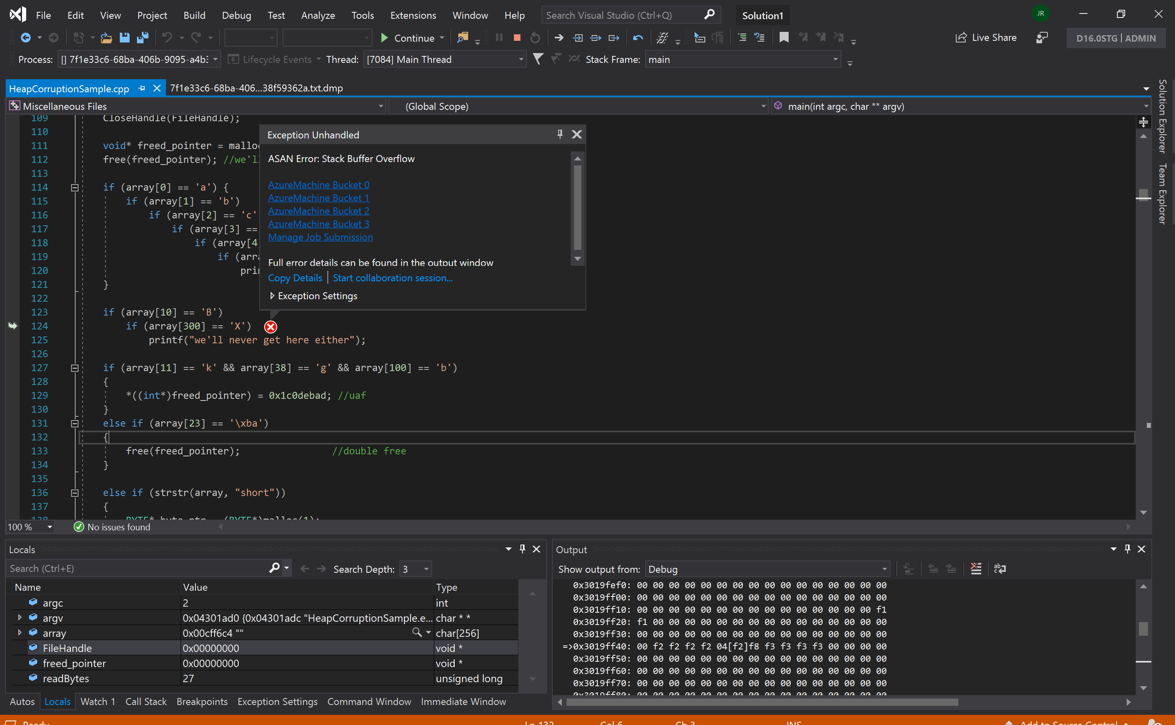
SNAPSHOT FILE

Slide 45
VS2019 Demo VC++/Asan/Fuzzing

Slide 46
Get started today
Fuzzing@Microsoft.com

Slide 47
APPENDIX
Screen shots from the live demo
jradigan@Microsoft.com

Slide 48
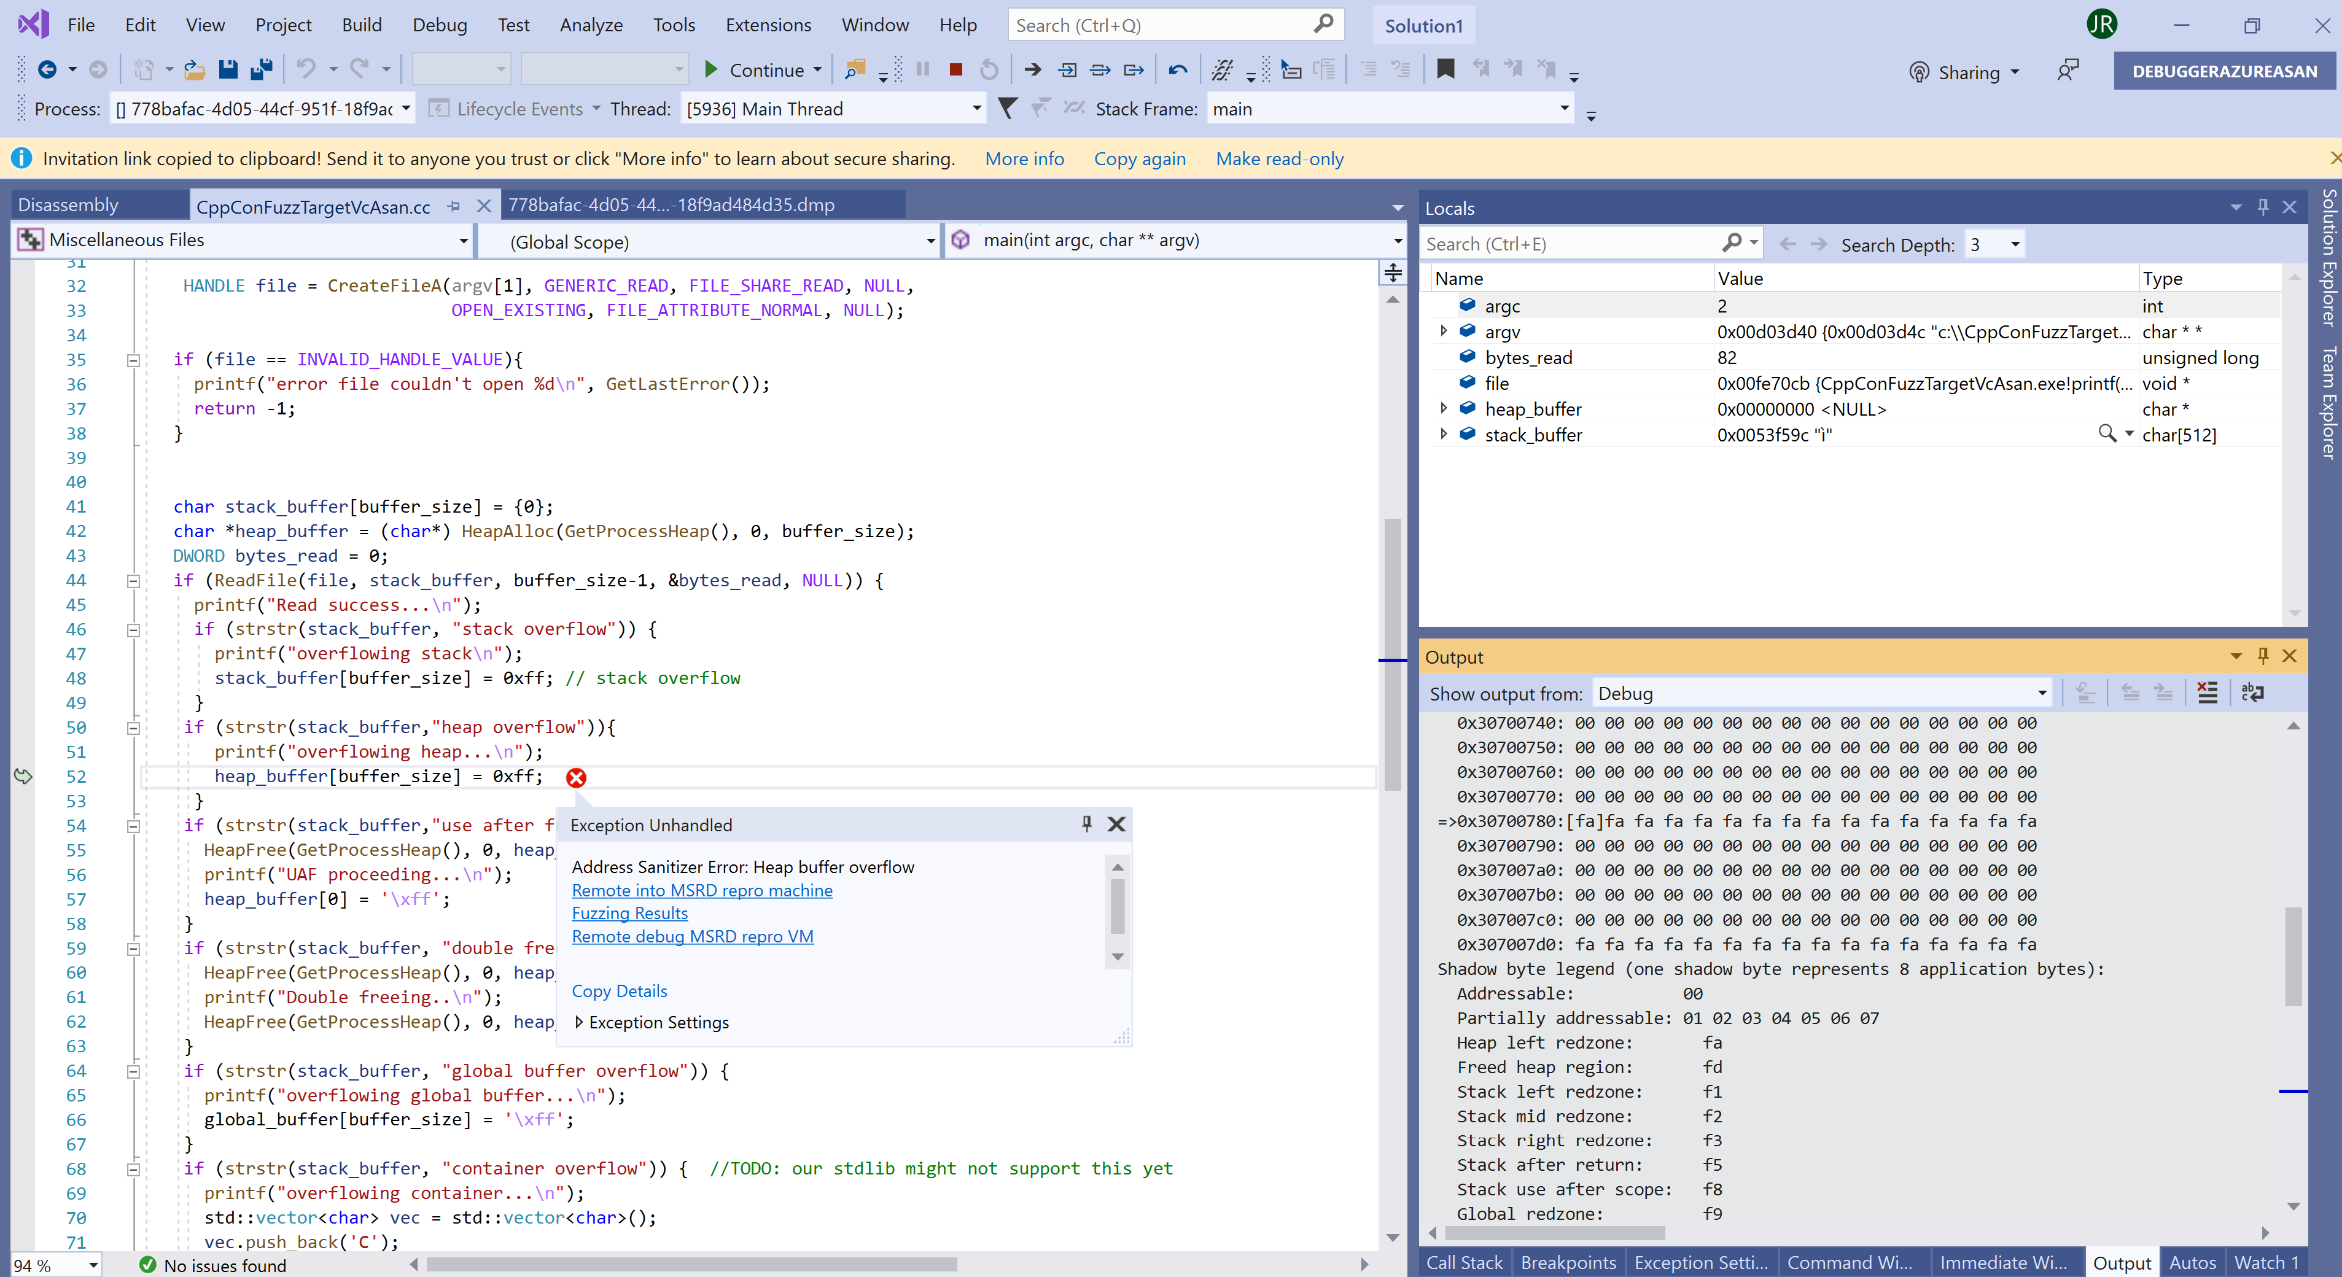
Snapshot file displayed with links back to MSRD service in the cloud. One click from a IM notification.

Slide 49
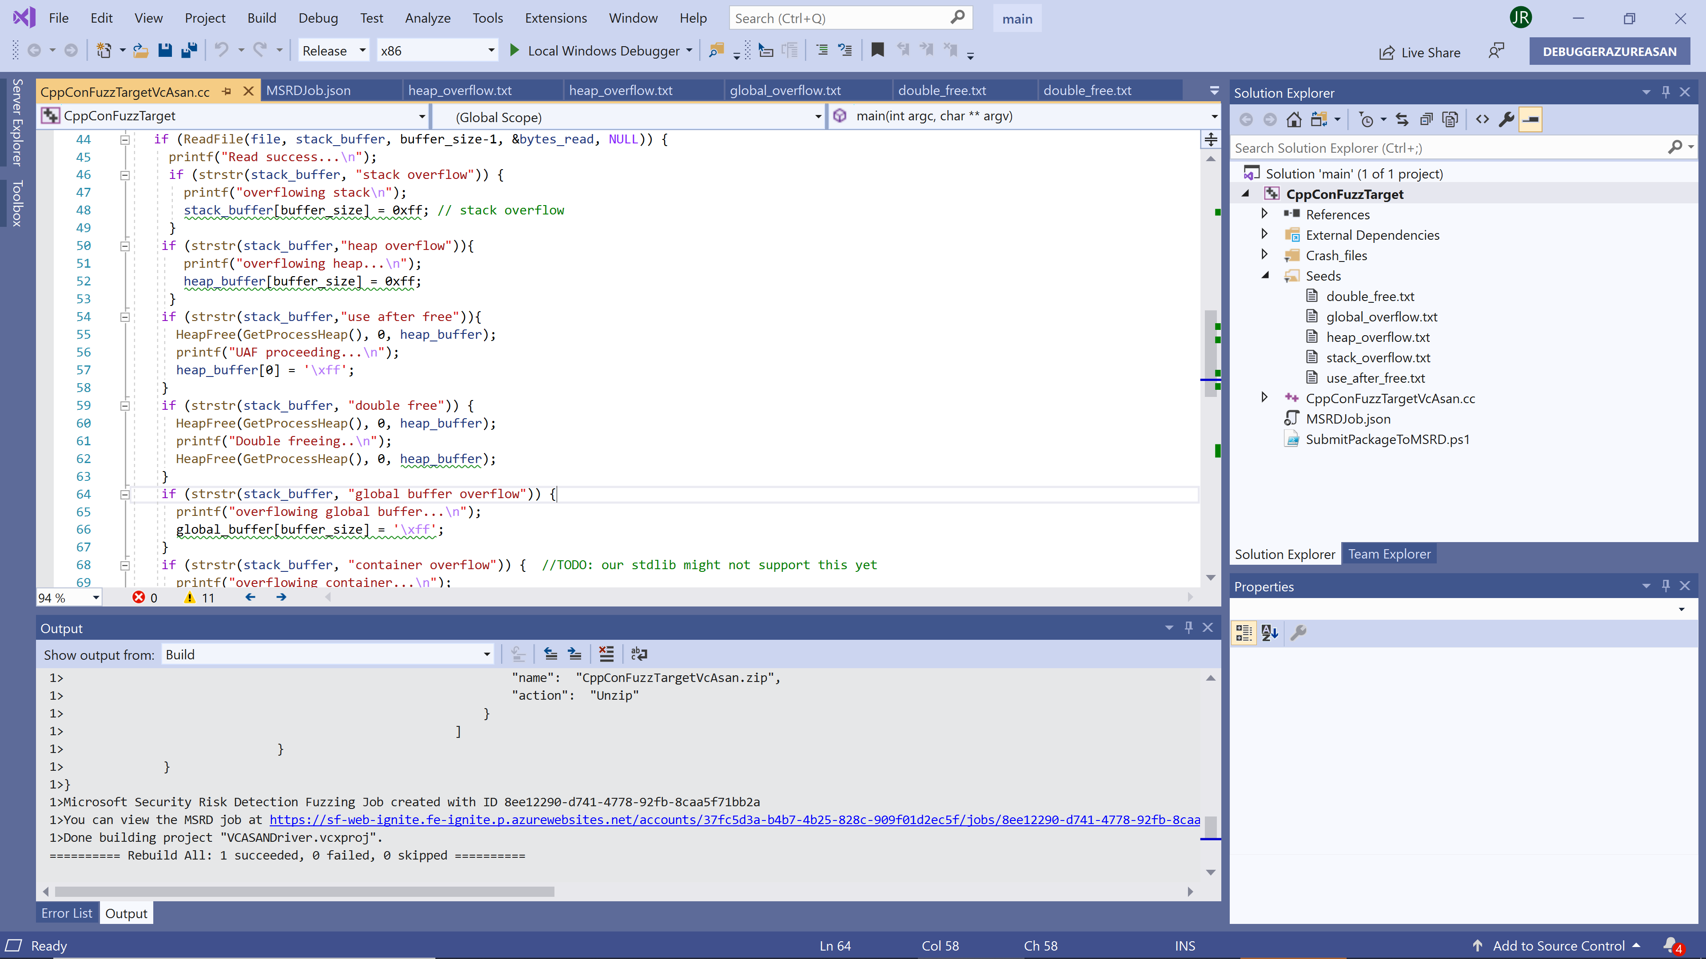
Sent to 40 machines in MSRD in the cloud, automatically One click – see output pane.

Slide 50
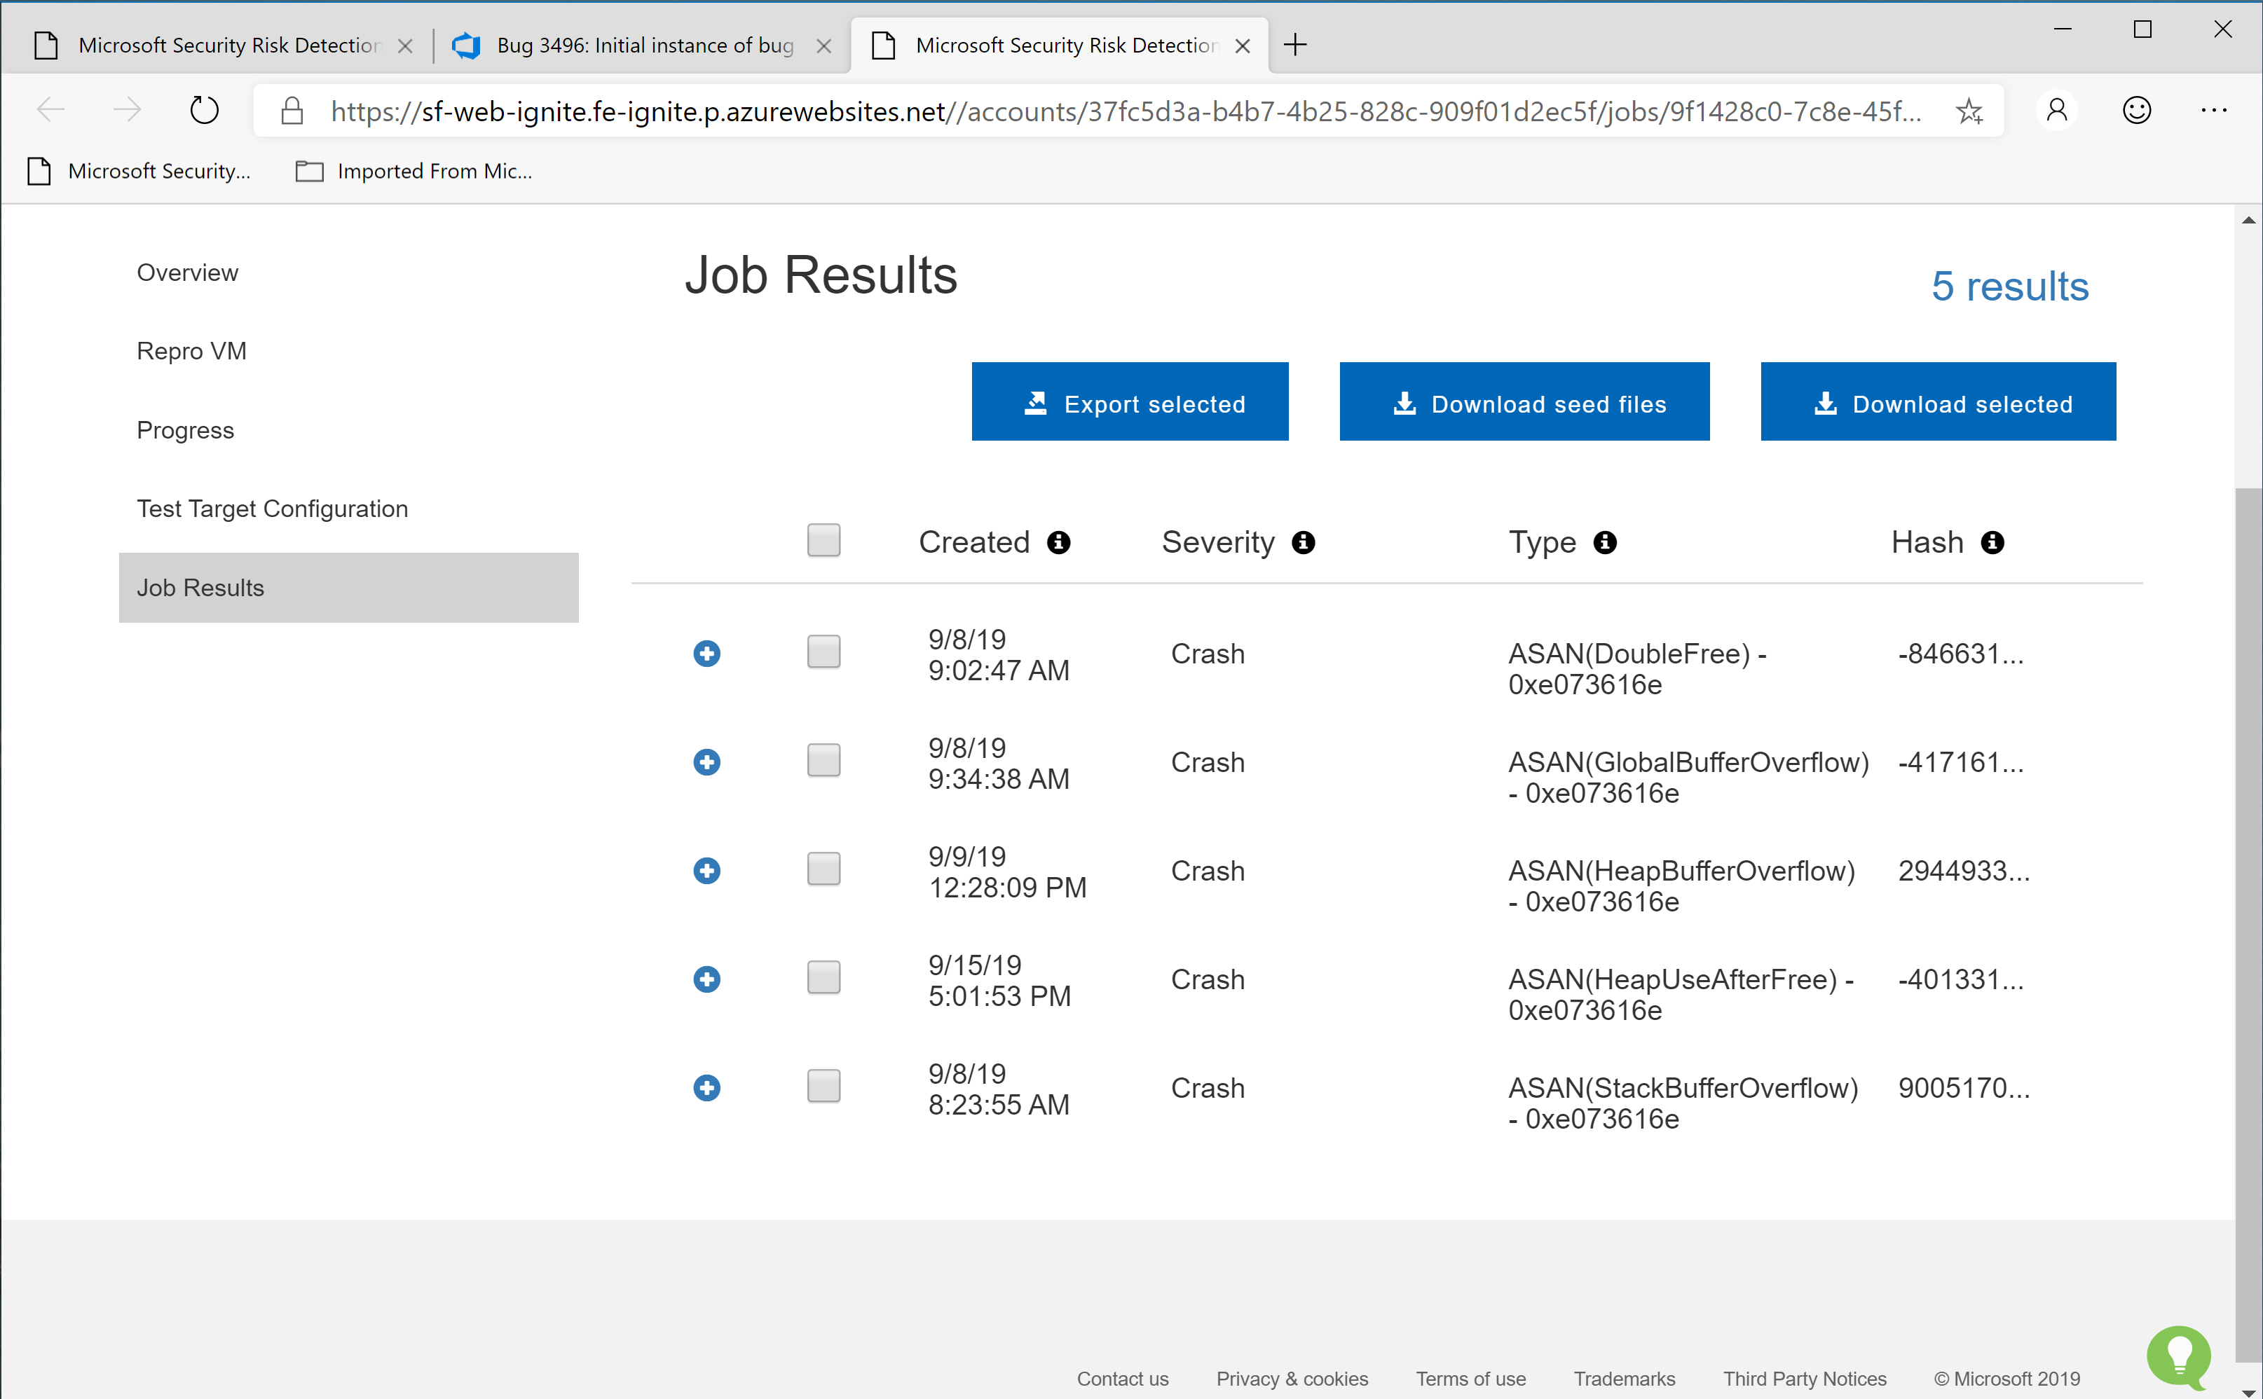
Found 5 unique memory safety bugs

Slide 51
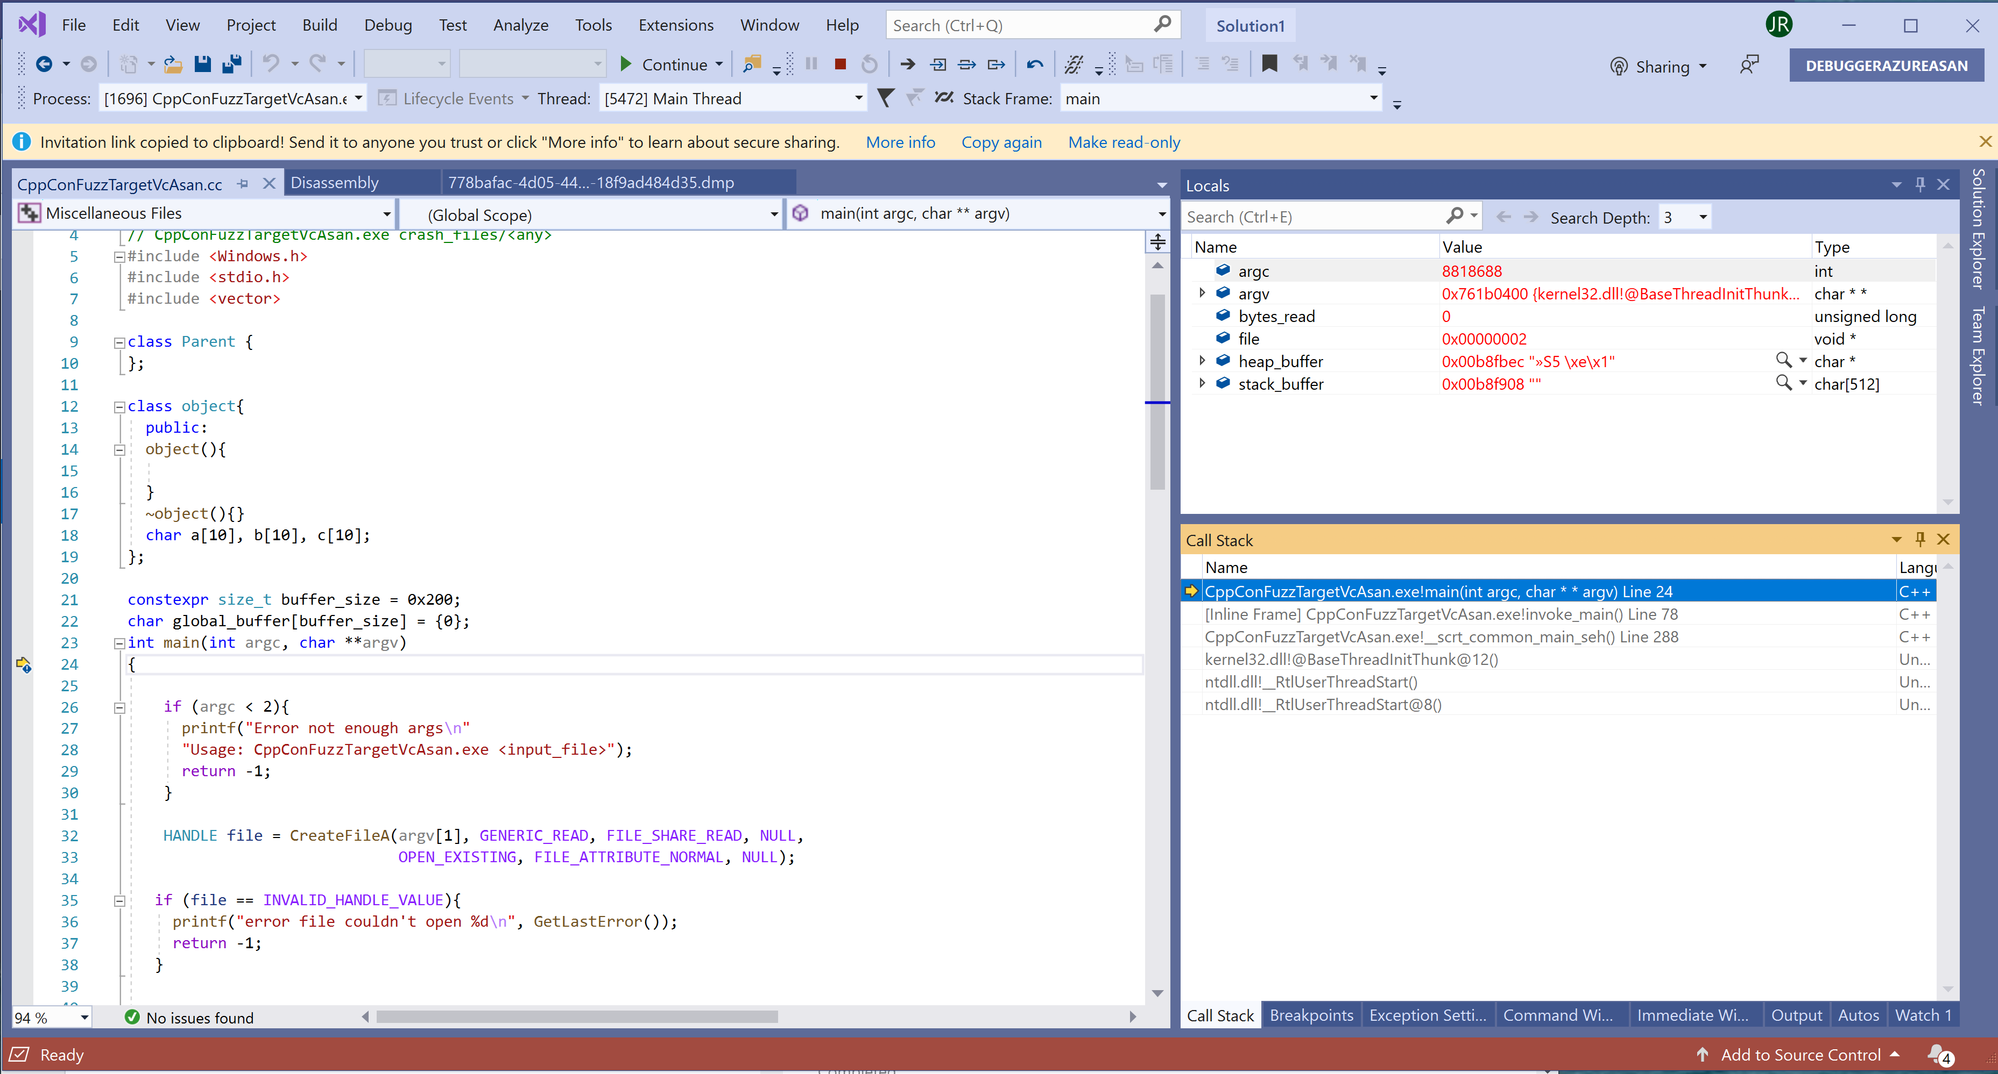
Up in remote debugging, stopped at main. In ONE click from the snapshot file!

Slide 52
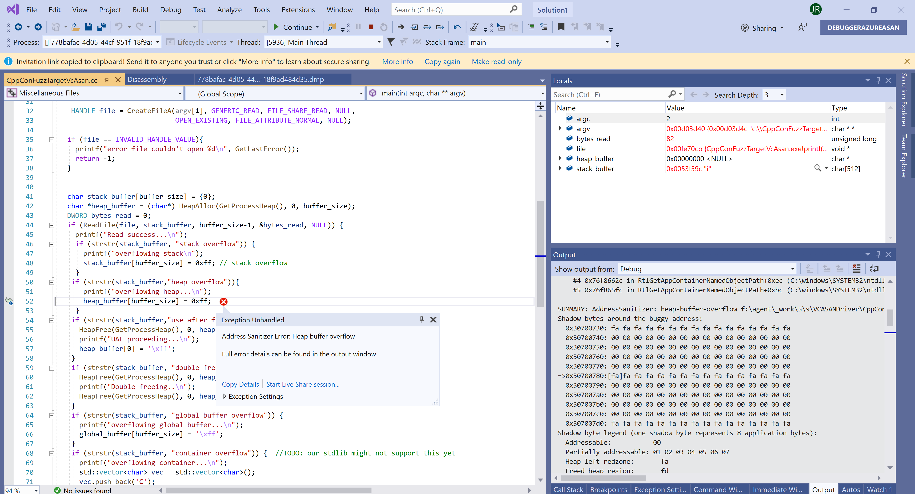
Ran the repro on the machine in the cloud from one click in the snapshot

Slide 53
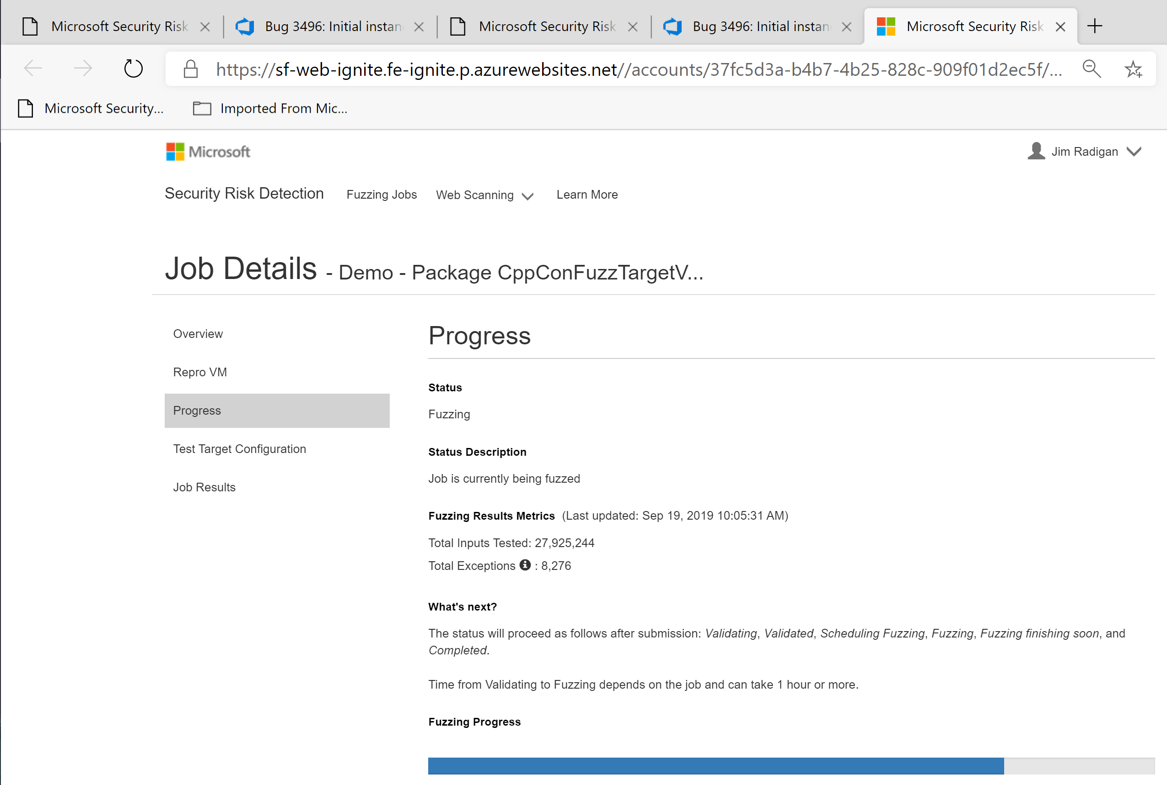
MSRD – fuzzing stats

Slide 54
